Slide 1
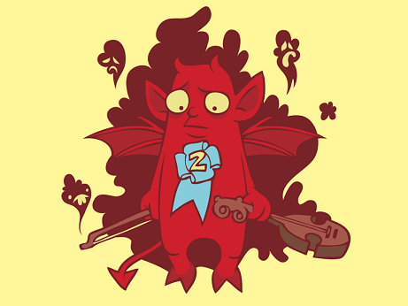
HOW TO
TAKE SECOND AT A
HACKATHON
ROB SPECTRE
@dN0t

Slide 2
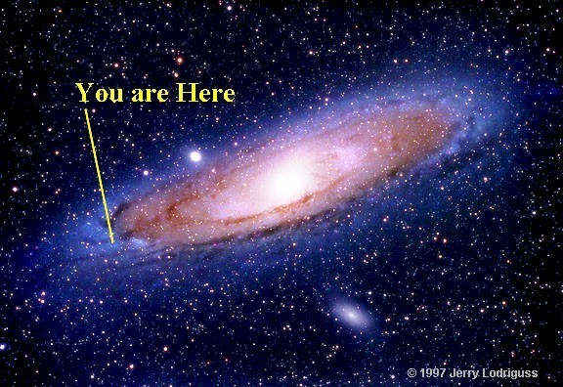
SO.
HERE YOU ARE

Slide 3

LOOK WHAT YOU AREN'T
GETTING THIS WEEKEND

Slide 4
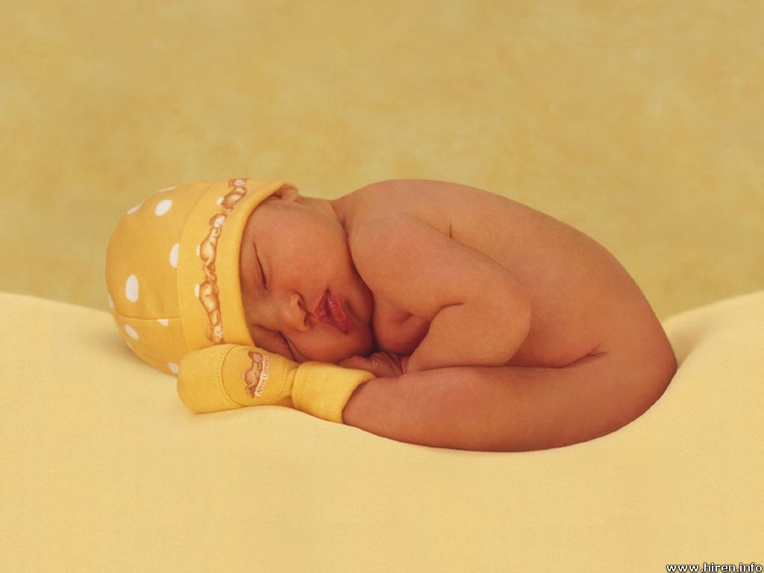
YOU AREN'T GETTING
SLEEP

Slide 5
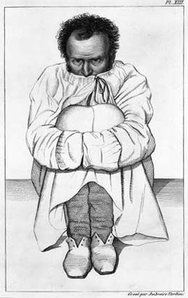
YOU AREN'T GETTING
SANITY

Slide 6
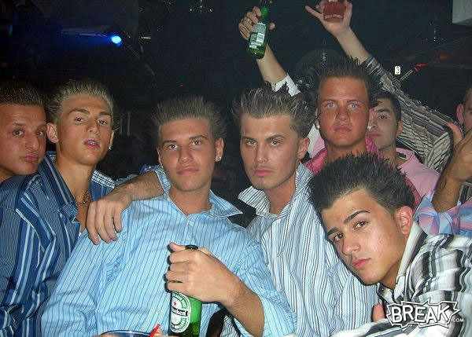
YOU AREN'T GETTING
BOTTLE SERVICE

Slide 7
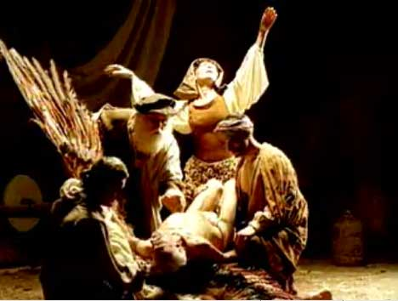
YOU ARE LOSING
MY RELIGION

Slide 8

MY KIND OF
MUTANT

Slide 9
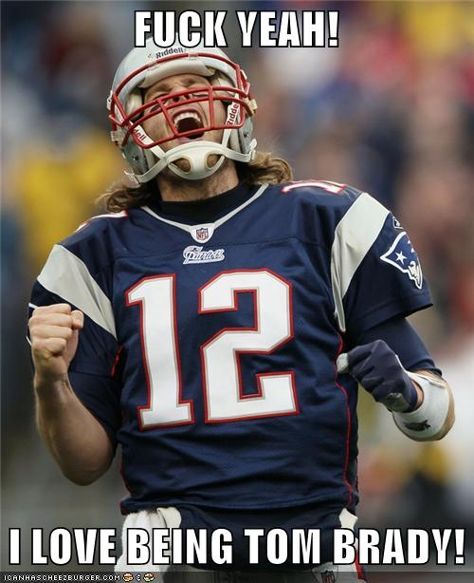
MY KIND OF
HERO

Slide 10
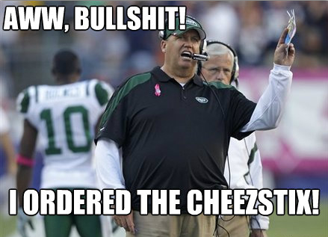
MY KIND OF
2-3 START

Slide 11
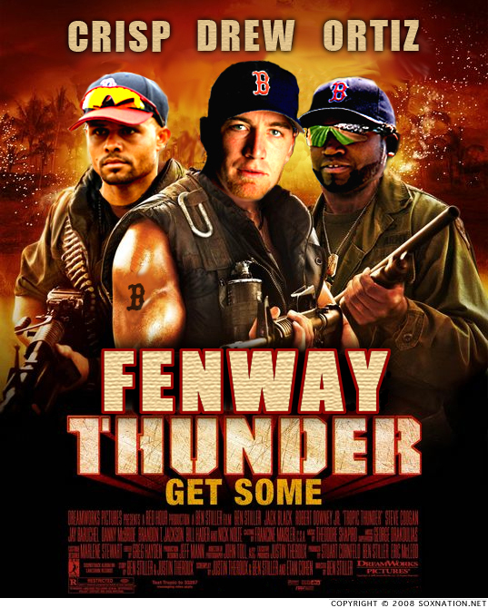
BRING THE
THUNDER

Slide 12
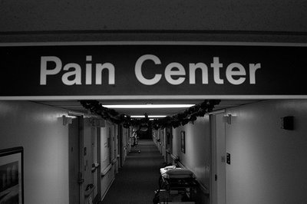
DELIVER THE
PAIN

Slide 13
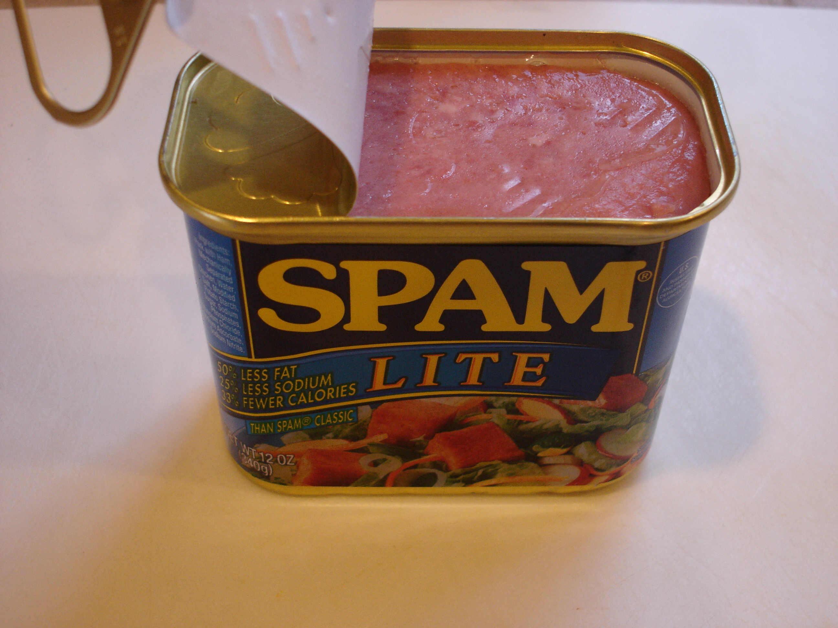
OPEN A
CAN

Slide 14
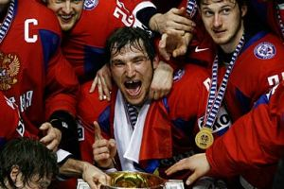
TAKE HOME THE
GOLD

Slide 15
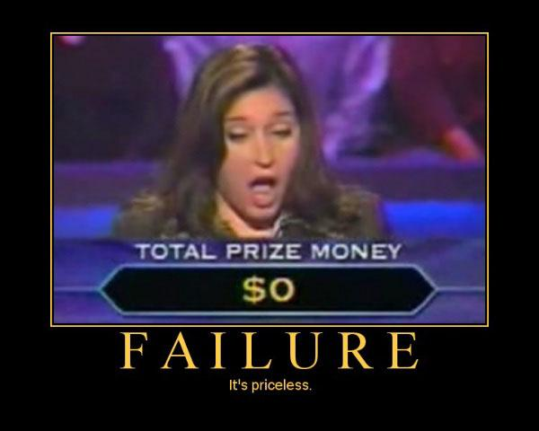
GOOD LUCK
WITH THAT

Slide 16
SECOND PLACE
SECOND FIDDLE

Slide 17
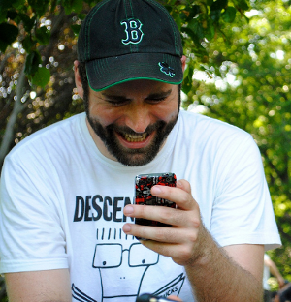
OH
HAI

Slide 18
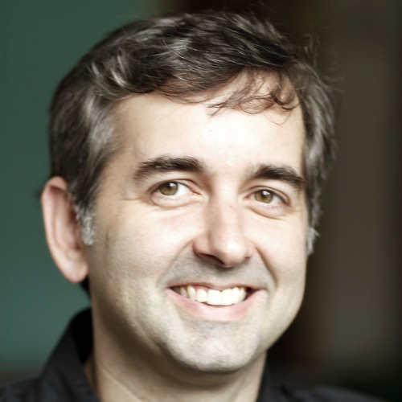
BEEN AT THIS
A WHILE

Slide 19
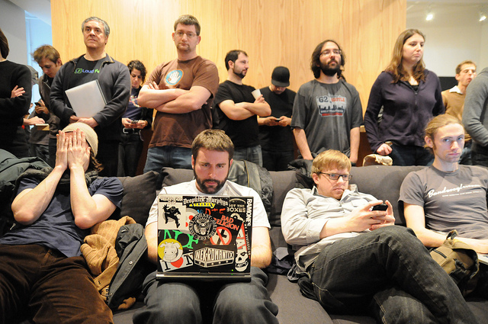
MY MA WOULD HAVE
PREFERRED THE TIMES

Slide 20

WHY NOT FIRST
PRIZE?

Slide 21
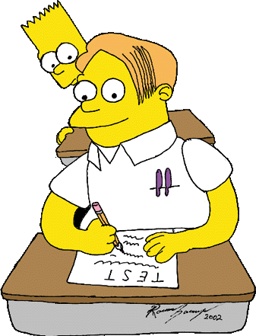
JUST
CHEAT

Slide 22
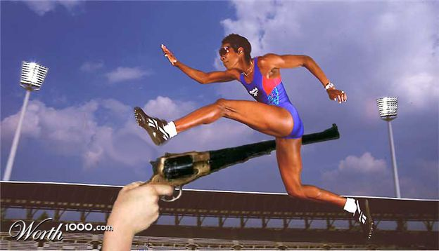
JUMP THE
GUN

Slide 23

BRING YOUR FRIEND
SEAN

Slide 24
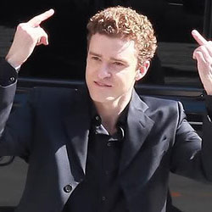
BRING YOUR FRIEND
JUSTIN

Slide 25
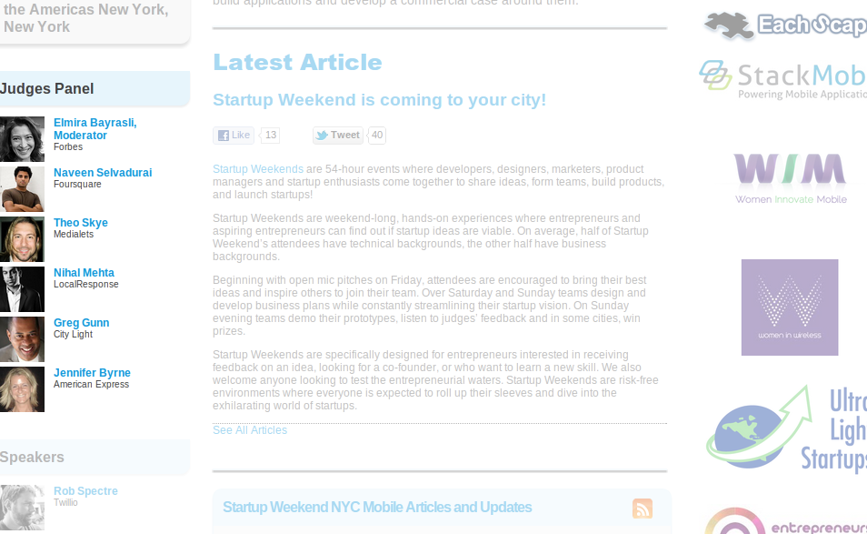
STACK THE
DECK

Slide 26
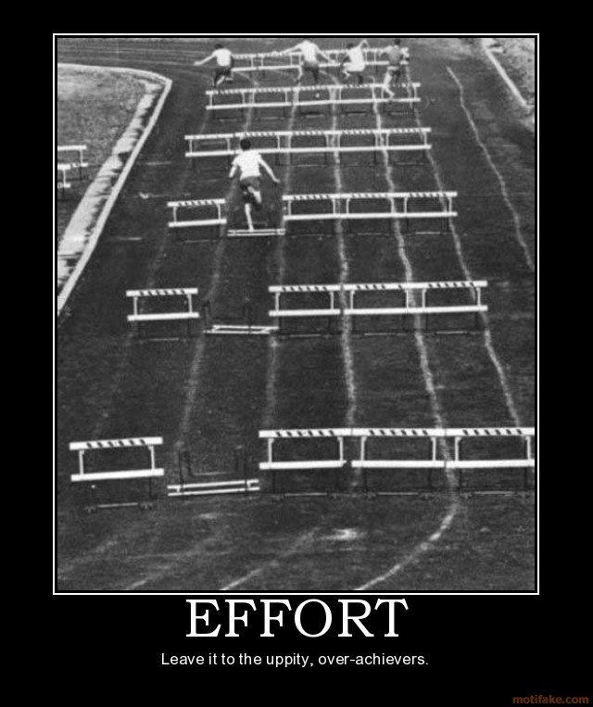
SECOND PLACE
IS HARDER

Slide 27
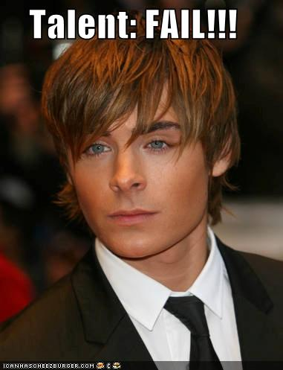
SECOND PLACE MEANS
TALENT

Slide 28
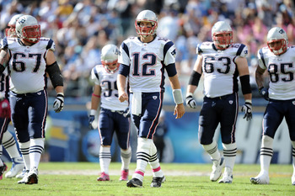
SECOND PLACE MEANS
TEAMWORK

Slide 29
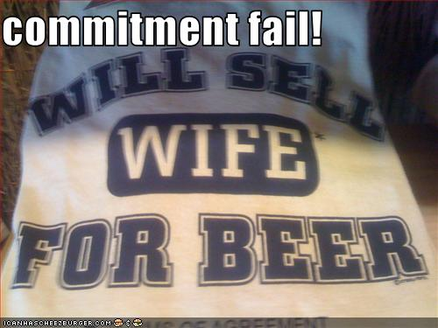
SECOND PLACE MEANS
COMMITMENT

Slide 30
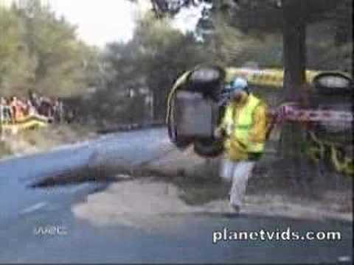
SECOND PLACE MEANS
LUCK

Slide 31

SECOND PLACE MEANS
SERIOUS BUSINESS

Slide 32
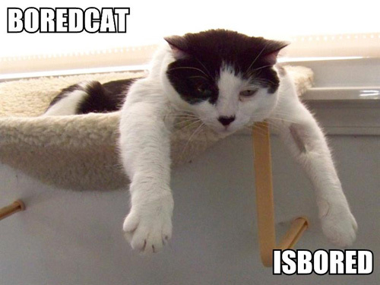
ARE WE SERIOUSLY
32 SLIDES IN?

Slide 33

UNLESS WHAT YOU KNOW
IS HARD TIME

Slide 34
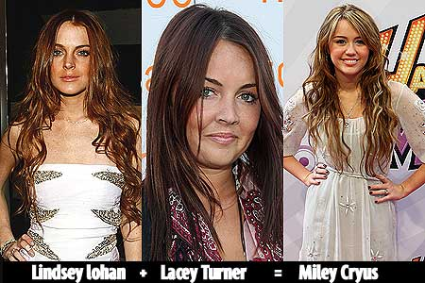
FAMILIAR
FACES

Slide 35
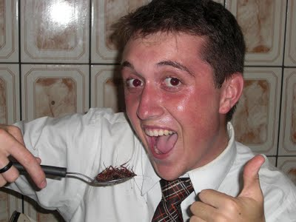
TRYING SOMETHING
NEW

Slide 36
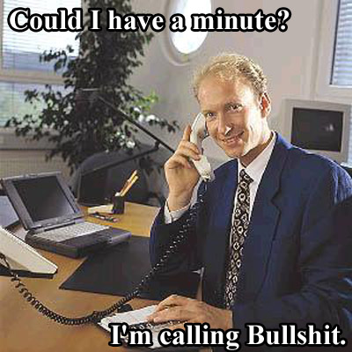
THIS ROOM KNOWS
A LOT ABOUT A LOT

Slide 37

GET TO THE DEMO,
MAN.

Slide 38
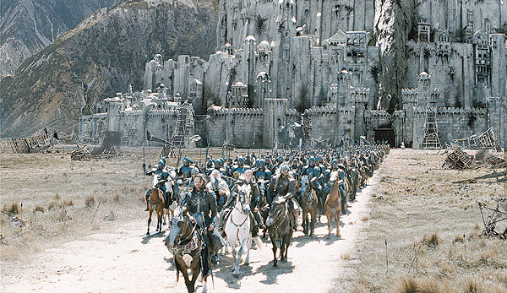
YOU'RE NOT BUILDING
A CASTLE

Slide 39
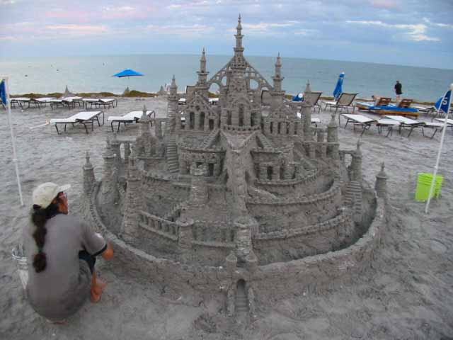
YOU'RE NOT BUILDING
A SANDCASTLE

Slide 40

YOU'RE NOT BUILDING
A BUCKET OF RAINBOWS

Slide 41
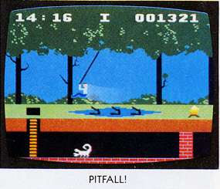
AVOID COMMON
PITFALLS

Slide 42
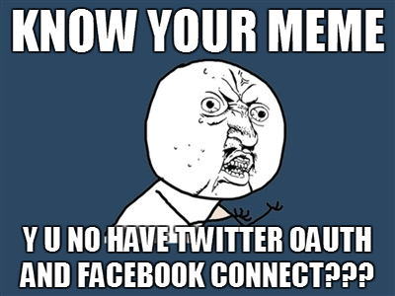
OAUTH IS A ROUGH
FIRST RODEO

Slide 43
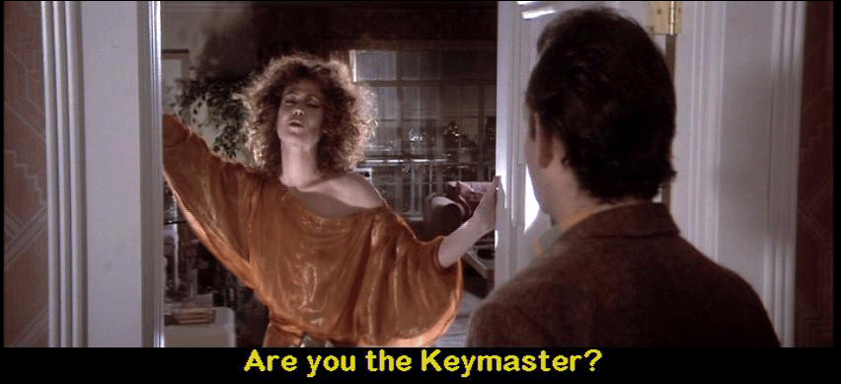
USERS ARE
NO JOKE

Slide 44
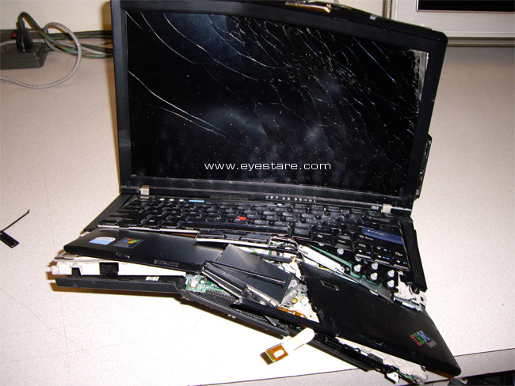
IT IS BROKEN IF
IT IS ON YOUR LAPTOP

Slide 45
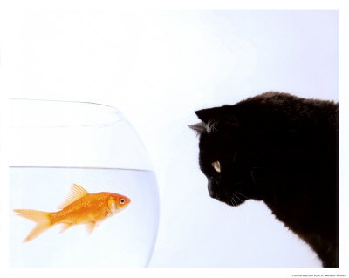
EYE ON THE
PRIZE

Slide 46

THE ZEN
OF HACKATHONS

Slide 47
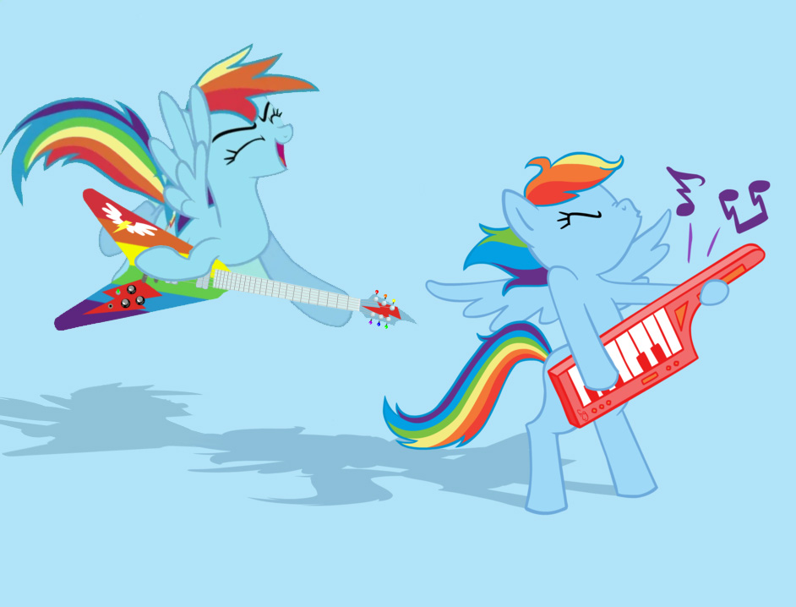
DOUBLE RAINBOW
ALL THE WAY

Slide 48
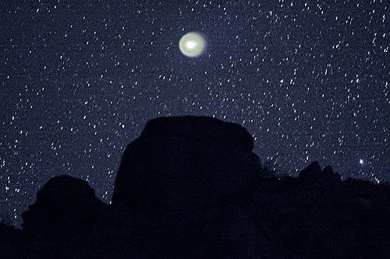
MOST SENTIMENTAL
SLIDE OF THE DECK

Slide 49
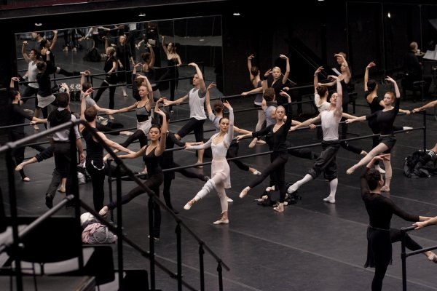
REHEARSE REHEARSE
REHEARSE

Slide 50

FOUR MINUTES OF
OF CHRISTOPHER PLUMMER

Slide 51
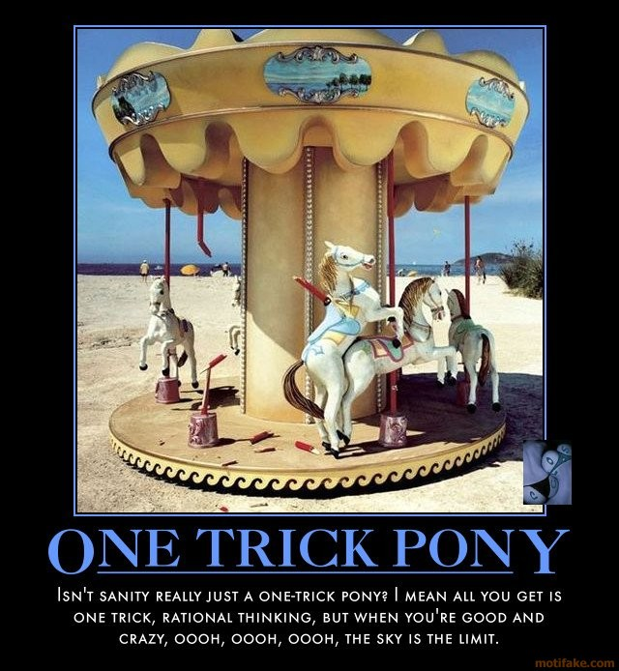
ONE TRICK
PONY

Slide 52
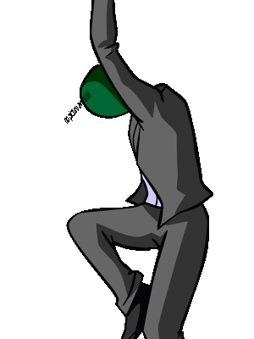
PARTY
HARD

Slide 53
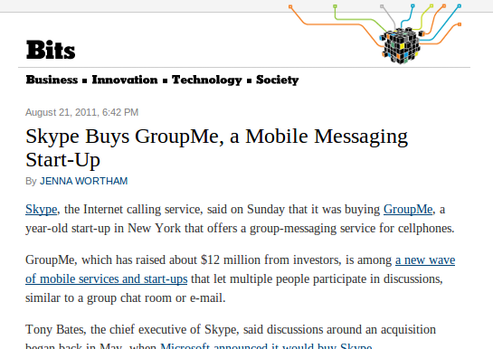
NOT PLACING
AIN'T TOO BAD

Slide 54
GITHUB.COM/RobSpectre/Talks
@dN0t
RSPECTRE @TWILIO.COM
BROOKLYNHACKER.COM

Slide 55
THANK
YOU!

